Slide 1

Real Time Analysis and visualization of Reddit's Asked Questions using Kafka, Spark Streaming, Hive/HBase, Spark SQL, and Tableau
Maharshi International University
Computer Science Department
Big Data Technology-Final Project
Advisor: Professor Mrudula Mukadam
Presenters:
Phuong Khanh Nguyen - Van Nhinh Nguyen - Giao Hieu Tran - Rahel Teklu

Slide 2
Outline
Introduction
Background of problem
Using of Spark Streaming
Using of Spark SQL, Hive, and HBase
Data visualization: Tableau
Demo of project
Spark SQL + Hive + HBase Issues

Slide 3

Introduction
This project aims to demonstrate a real-time data pipeline for extracting, transforming, loading, analyzing, and visualizing questions asked on Reddit.
The pipeline will utilize various technologies including Kafka for real-time data ingestion, Spark Streaming for data processing, HBase/Hive for data storage, Spark SQL for data querying and Tableau for data visualization.

Slide 4
Background of problem
The vast amount of unstructured data generated by Reddit's questions poses a challenge for real-time analysis. Traditional methods are insufficient for processing this data efficiently, hindering timely insights. Without a centralized platform for monitoring, identifying trends, and addressing user concerns, there's a pressing need for a solution to extract, process, and visualize Reddit's asked questions data for actionable insights.

Slide 5
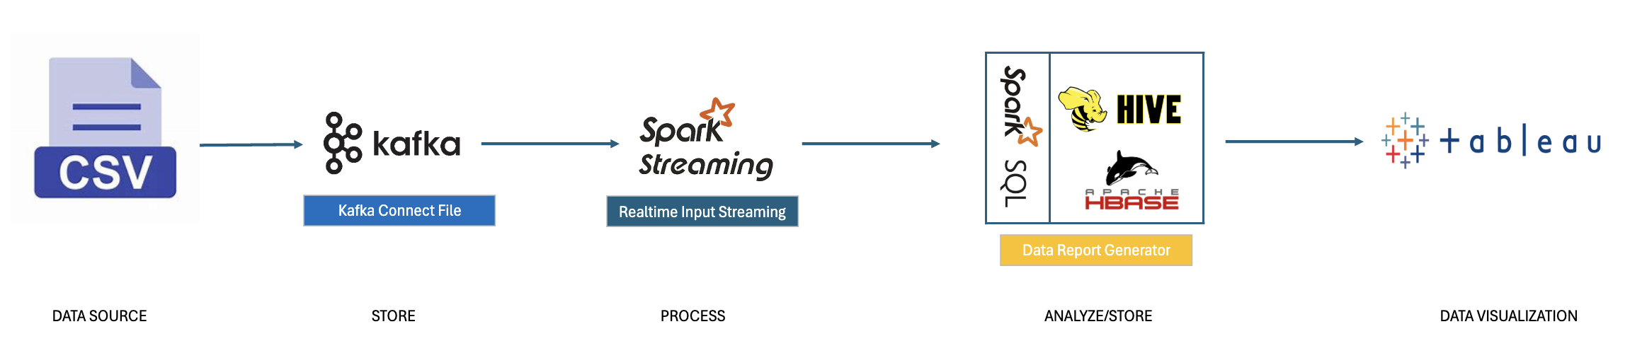
Streaming pipeline

Slide 6
Preparing environment
Kafka- is an open-source distributed event streaming platform
Kafka plays a pivotal role in modern data streaming architectures, serving as a distributed, fault-tolerant messaging platform that facilitates seamless data flow across applications and systems.​
Kafka plays a crucial role in enabling the construction of robust real-time data pipelines and powering event-driven applications, fostering agility and responsiveness in the rapidly evolving landscape of data processing and analysis.

Slide 7
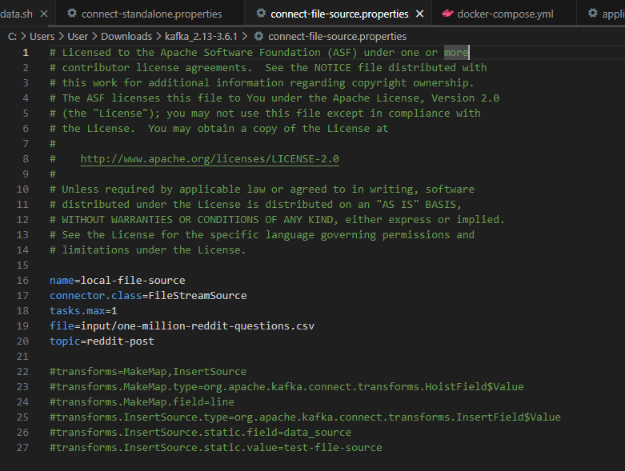
Connect File Source properties
Kafka Connectors allow Kafka to ingest data from the data source into Kafka topics​.
Connector configuration has the ff info and settings:​
name=local-file-source # Identifier for the Kafka Connector.​
connector.class=FileStreamSource # Implementation class for reading data from a file.​
file=input/one-million-reddit-questions.csv # Path to the input CSV file.​
topic=reddit-post # Kafka topic where data from the CSV file will be published.​

Slide 8
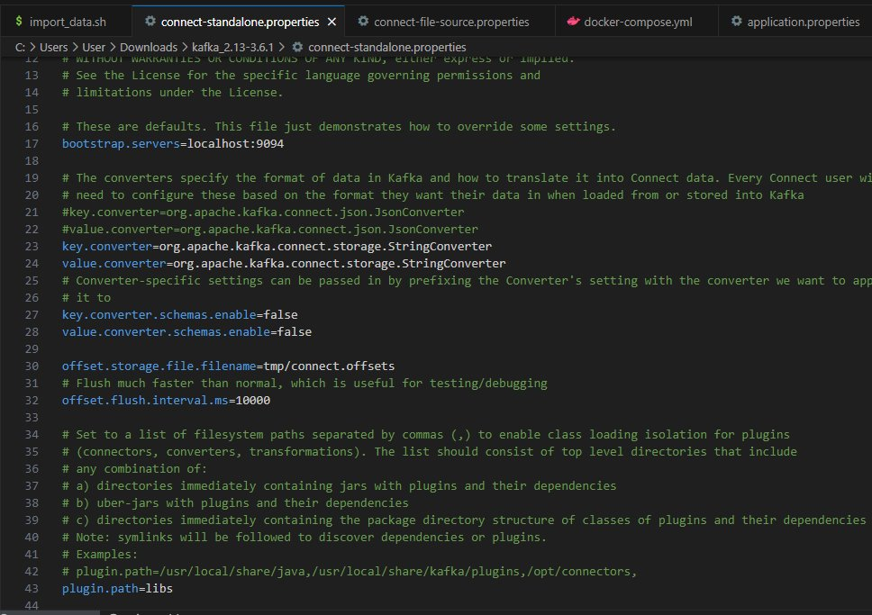
Connect Standalone properties

Slide 9
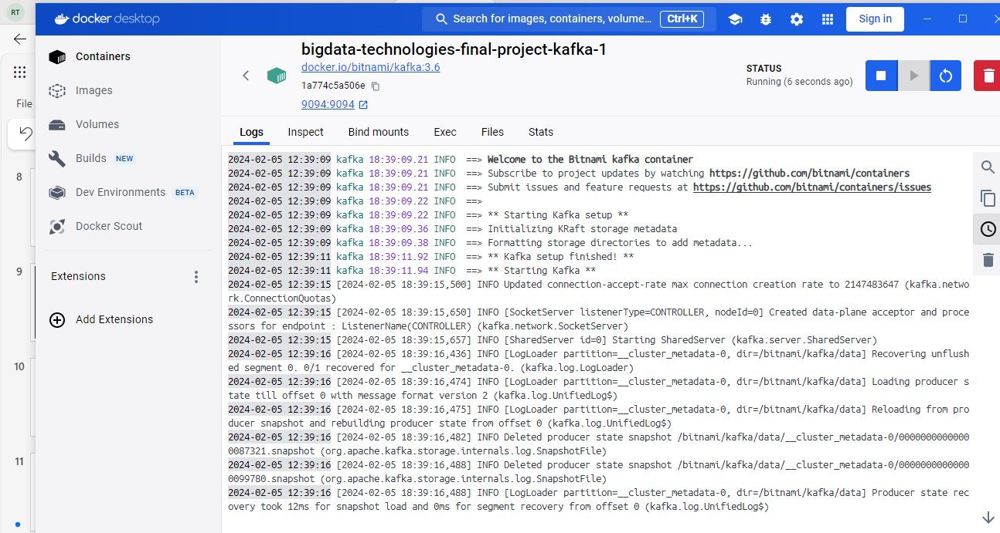
Kafka Instance

Slide 10

Spark Streaming
Realtime Input Streaming Component

Slide 11
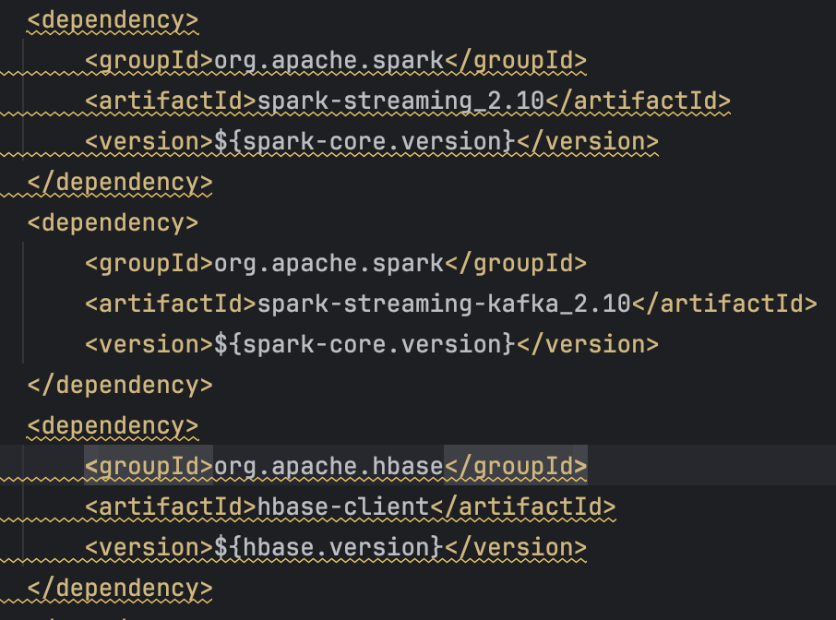
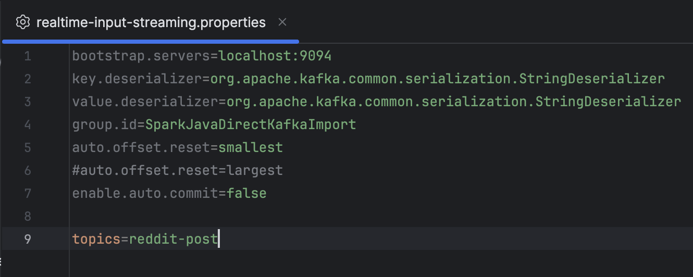
Spark Streaming
Realtime Input Streaming Component

Slide 12
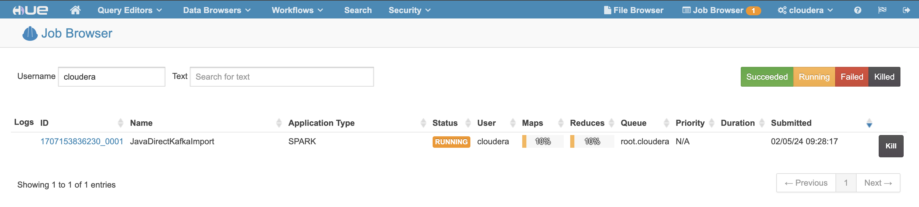
Spark Streaming
Realtime Input Streaming Component

Slide 13
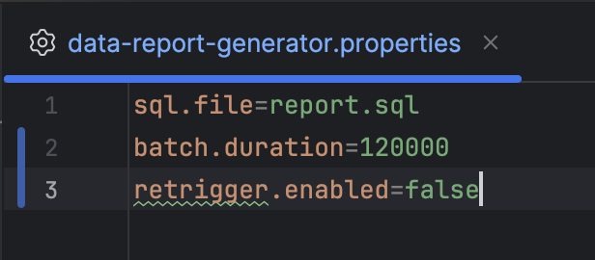
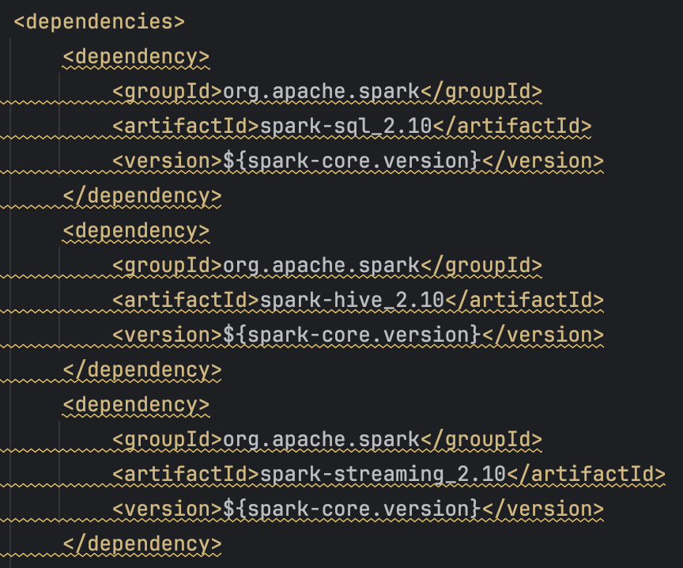
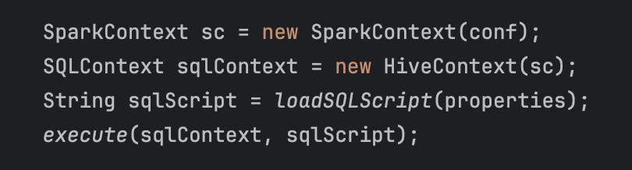
Spark SQL, Hive, and HBase
Data Report Generator

Slide 14
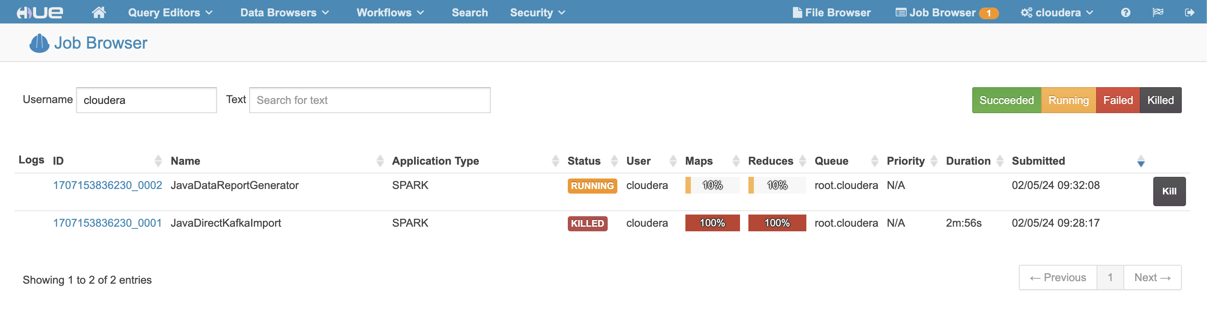
Spark SQL, Hive, and HBase
Data Report Generator

Slide 15
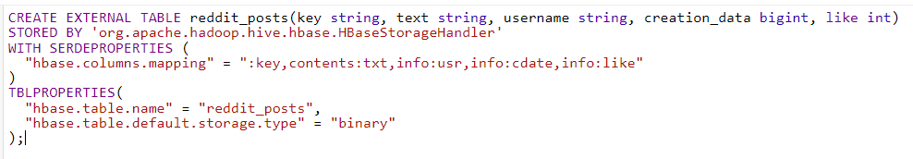
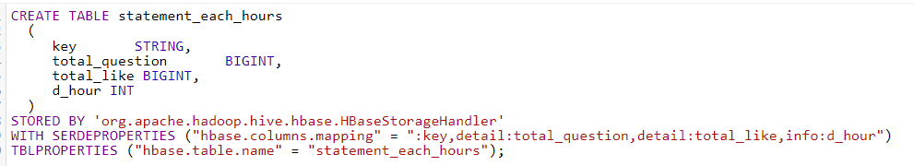
Spark SQL, Hive, and HBase
We can use Hive on top of HBase, it is convenient for query.
Step 1: Bind main table at hbase to hive
Step 2: Bind report table "statement_each_hours" to store report query result

Slide 16
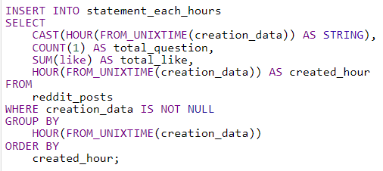
Spark SQL, Hive, and HBase
Step 3: Load query result into "statement_each_hours"

Slide 17
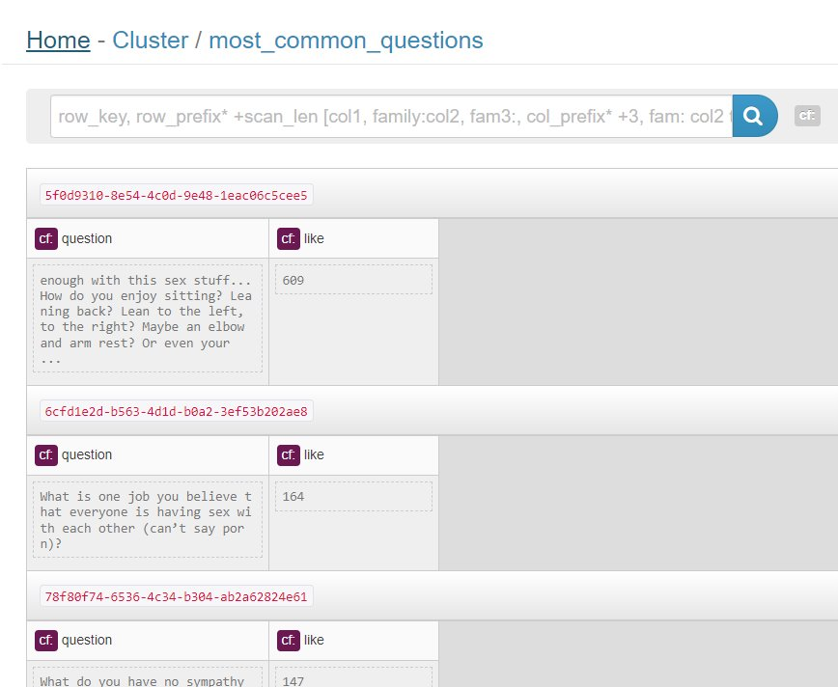
Spark SQL, Hive, and HBase
Result:

Slide 18
Data visualization: Tableau​
What is Tableau?​
Tableau is a powerful data visualization tool used for creating interactive and shareable dashboards, reports, and visualizations
​
Why would we use Tableau?
Ease of Use: Tableau provides a user-friendly interface that allows users to create complex visualizations with simple drag-and-drop actions, requiring little to no coding skills.
Versatility: It can connect to various data sources including spreadsheets, databases, cloud services, and big data sources, enabling users to work with diverse datasets.
Scalability: It's capable of handling large datasets and complex visualizations without sacrificing performance, making it suitable for both small-scale and enterprise-level applications.
Sharing and Collaboration: Tableau enables users to easily share their visualizations and insights with others through Tableau Server, Tableau Online, or by exporting to various formats like PDF or image files.
​

Slide 19
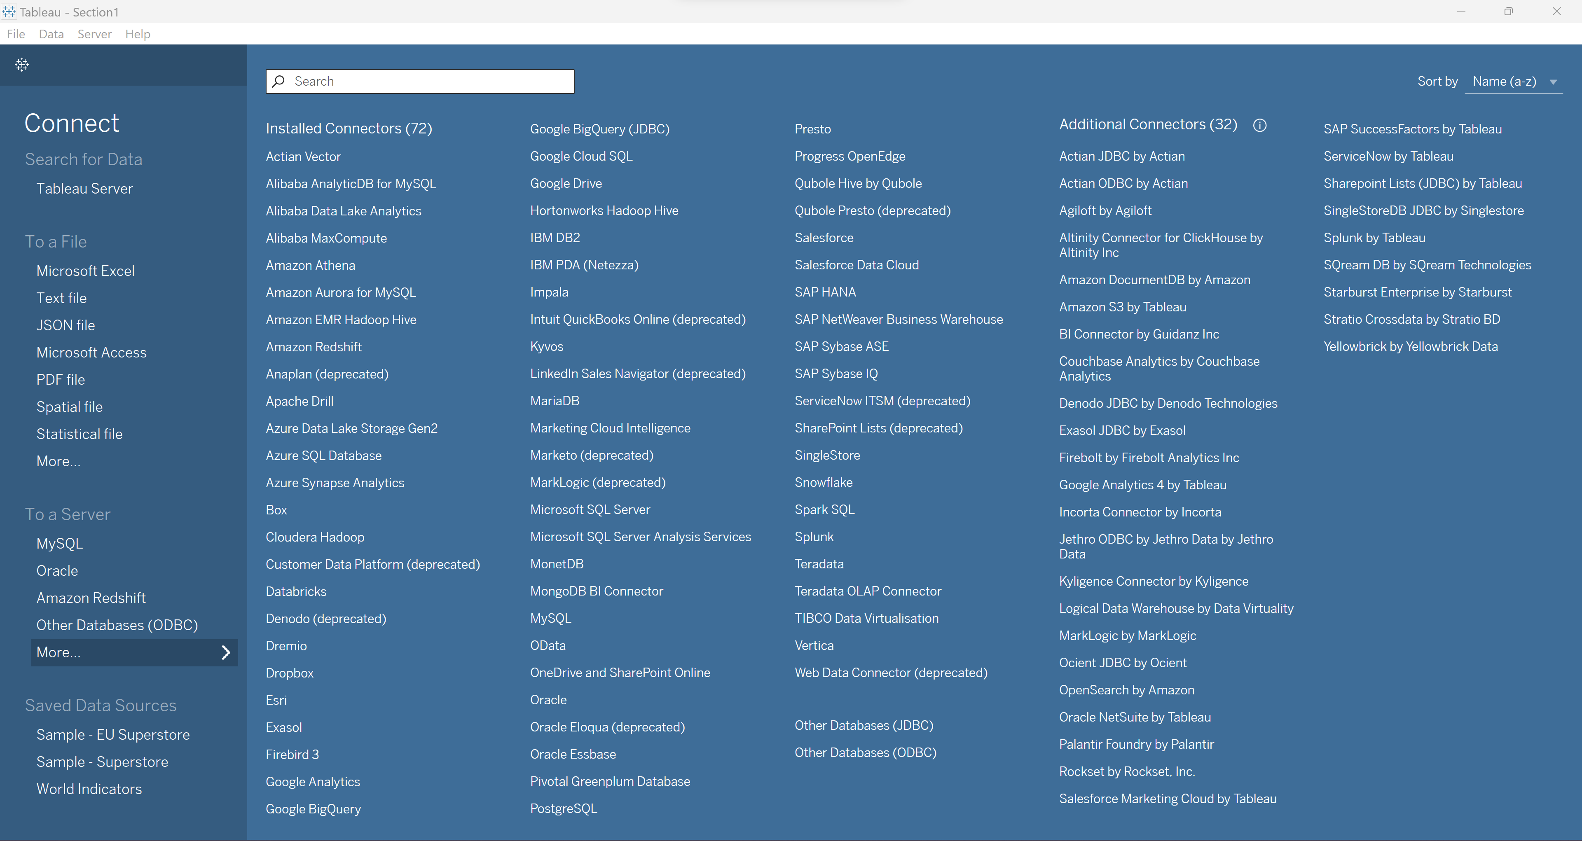
Data visualization: Tableau​
Supports:

Slide 20
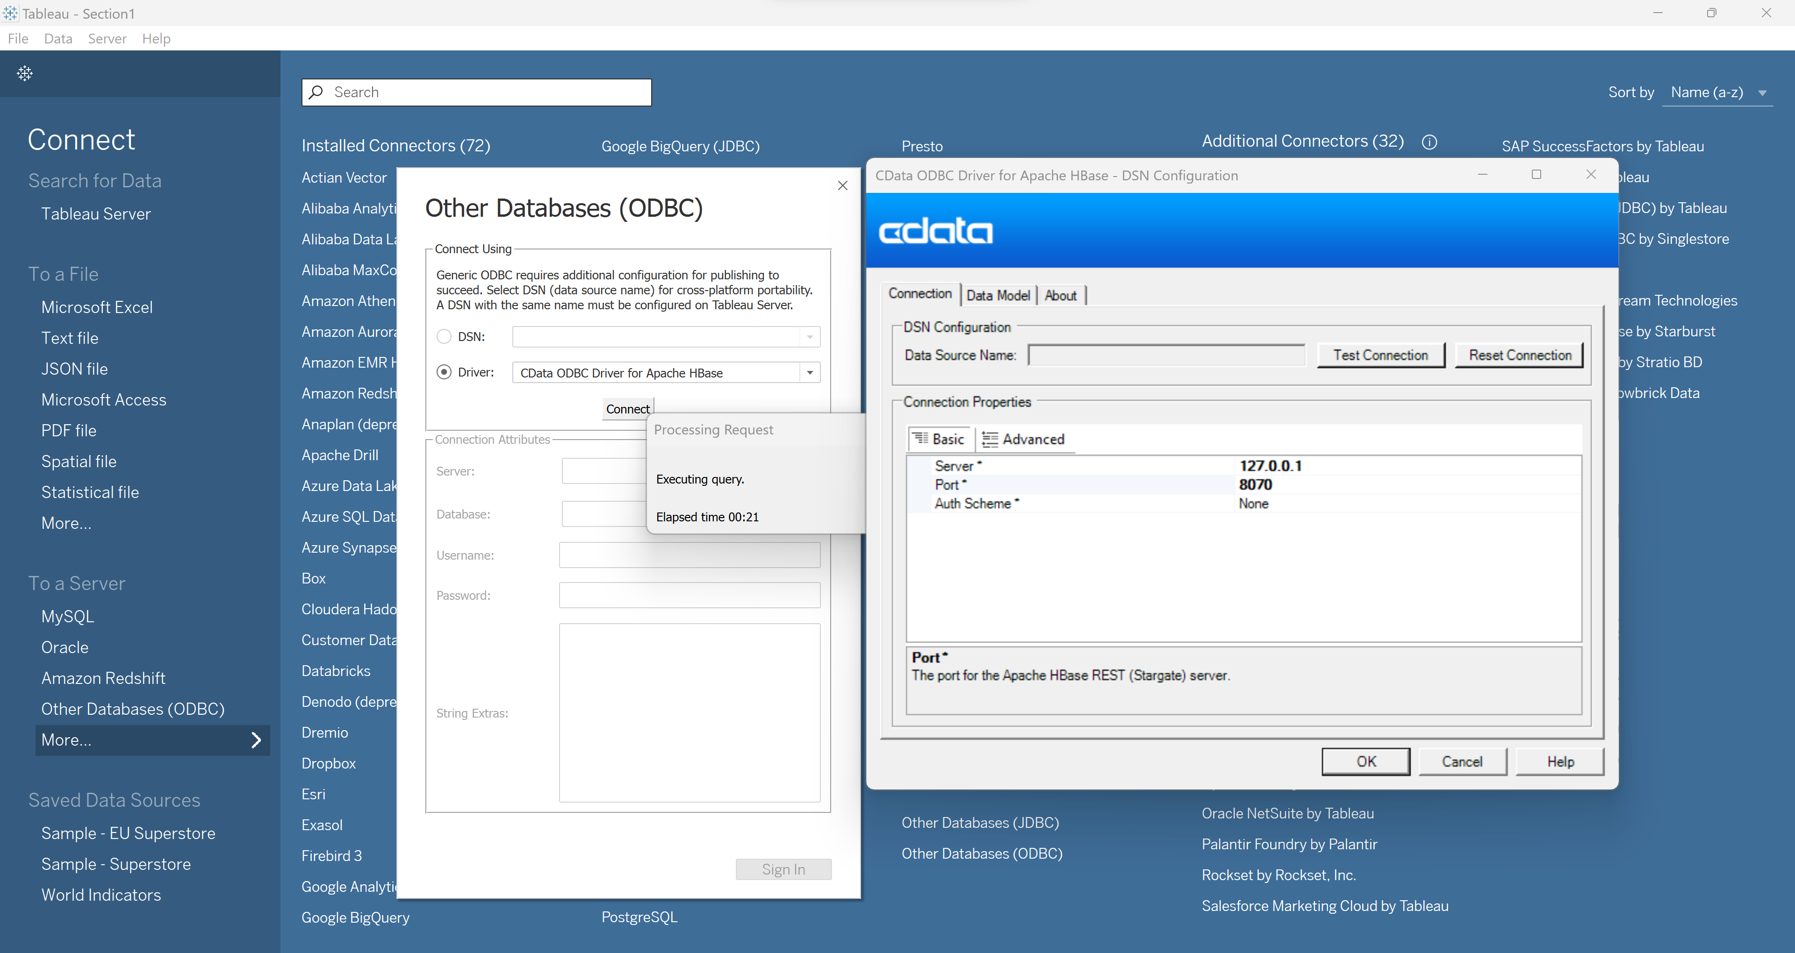
Data visualization: Tableau​
Connect:
HBase

Slide 21
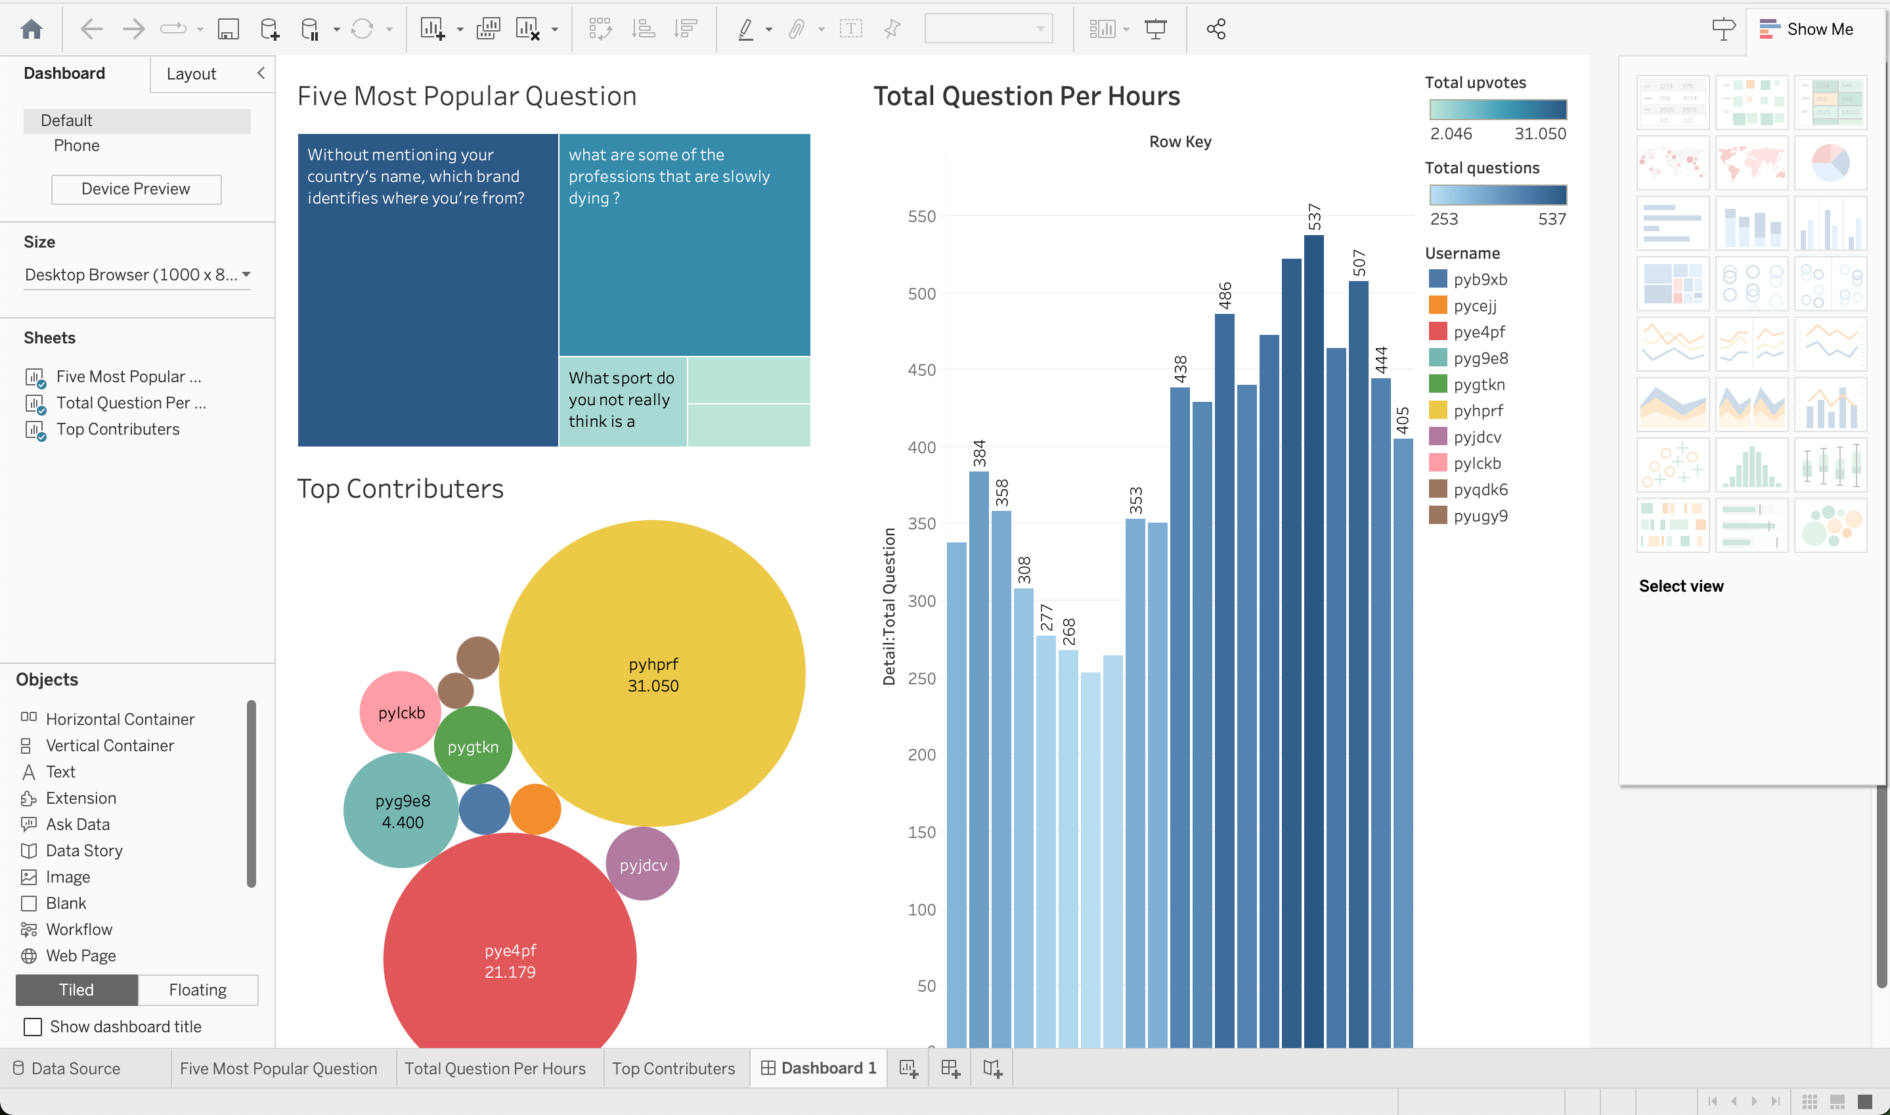
Data visualization: Tableau​
Result:

Slide 22
Demo of product using

Slide 23
Spark SQL + Hive + HBase Issues​
We discovered an issue on Spark SQL 1.6.0 that it cannot execute "INSERT INTO" statement
Issue details: https://github.com/apache/spark/pull/17989

Slide 24
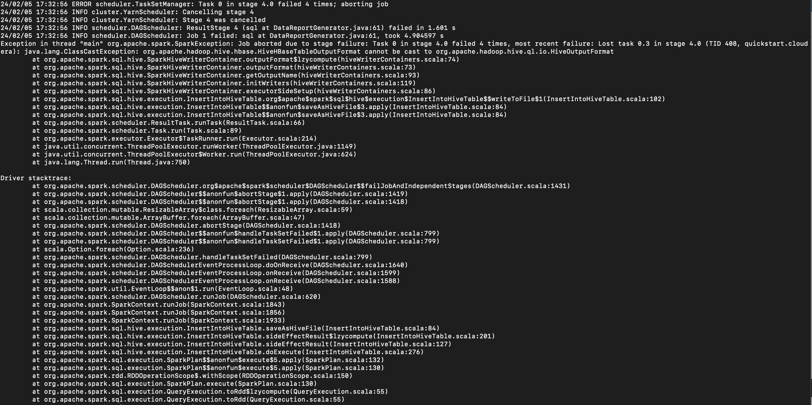
Spark SQL + Hive + HBase Issues​
Error log:

